Slide 1
Supervised Learning
Neurons, Neural Networks
S.V.Jansi Rani
Associate Professor / CSE
UCS 1603 Introduction to Machine Learning

Slide 2
Agenda
The brain and the neuron
Neural networks
The Perceptron

Slide 3







Slide 4
The Brain and the Neuron
Brain is an impressively powerful and complicated system, the basic building blocks that it is made up of are fairly simple and easy to understand
It deals with noisy and even inconsistent data, and produces answers that are usually correct from very high dimensional data (such as images) very quickly (1.5 kg).
It loses some parts of itself all the time (neurons die as you age at impressive/depressing rates), but its performance does not degrade appreciably (robust)
Processing units -nerve cells called neurons
100 billion = 10¹¹ different types, 100 trillion synapses
General operation – Transmitter chemicals within the fluid of the brain raise or lower the electrical potential inside the body of the neuron

Slide 5
If this membrane potential reaches some threshold, the neuron spikes or fires, and a pulse of fixed strength and duration is sent down the axon.
The axons divide (arborise) into connections to many other neurons, connecting to each of these neurons in a synapse.
After firing, the neuron must wait for some time to recover its energy (the refractory period) before it can fire again
Each neuron – processor -> use to model human intelligence inside a computer
Learning occurs - principal concept is plasticity: modifying the strength of synaptic connections between neurons, and creating new connections.

Slide 6
Hebb’s Rule
Hebb’s rule says that the changes in the strength of synaptic connections are proportional to the correlation in the firing of the two connecting neurons.
If two neurons consistently fire simultaneously, then any connection between them will change in strength, becoming
stronger.
However, if the two neurons never fire simultaneously, the connection between them will die away.
The idea is that if two neurons both respond to something, then they should be connected
Example :recognising your grandmother – face, chocolate (happiness), Pavlov- class conditioning to train his dogs
Idea that synaptic connections between neurons and
assemblies of neurons can be formed when they fire together and can become stronger. It is also known as long-term potentiation and neural plasticity

Slide 7
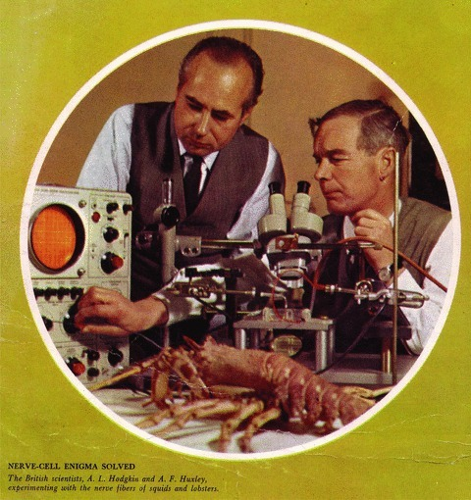
McCulloch and Pitts Neurons
Studying neurons isn’t actually that easy.
Hodgkin and Huxley (1952) - differential equations that compute the membrane potential of giant squid based on various chemical concentrations, something that earned them a Nobel prize in Physiology or Medicine ‘for their discoveries concerning the ionic mechanisms involved in excitation and inhibition in the peripheral and central portions of the nerve cell membrane’

Slide 8
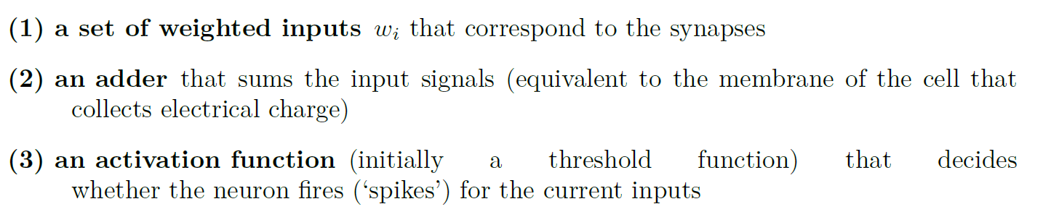
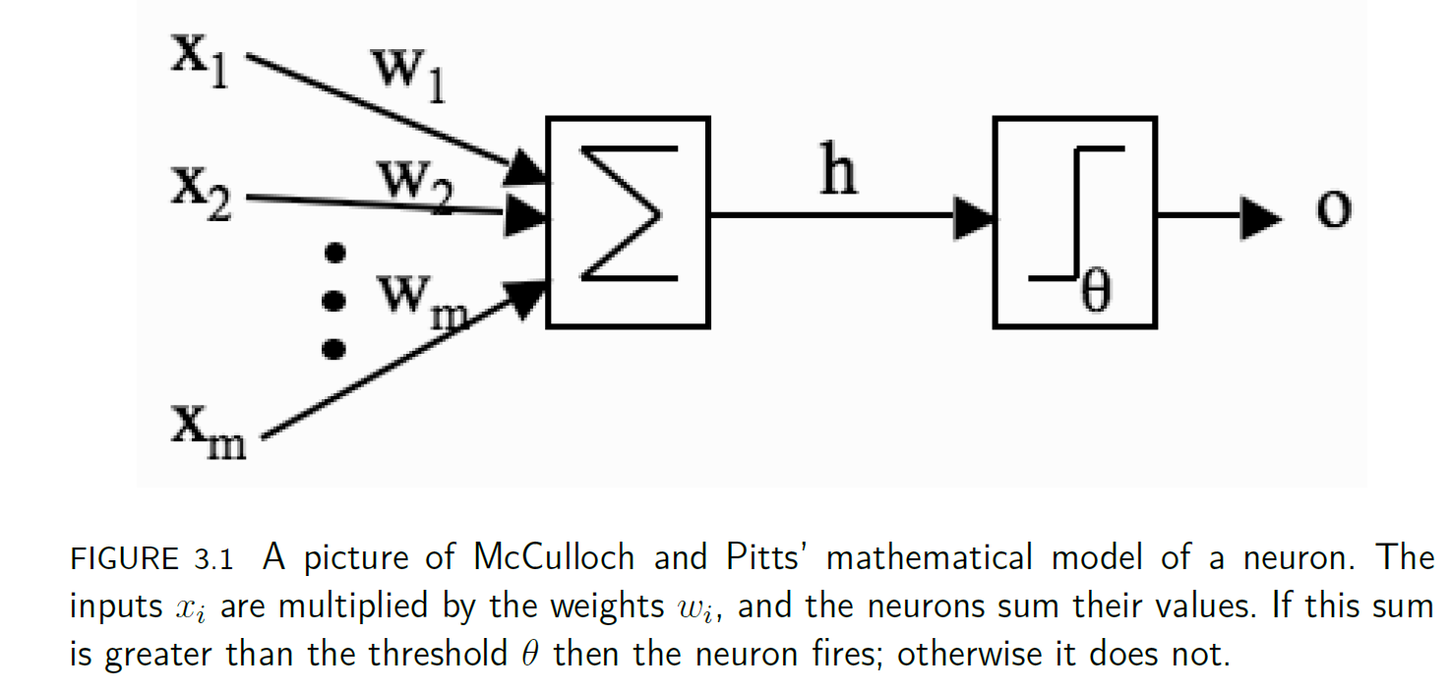

Slide 9
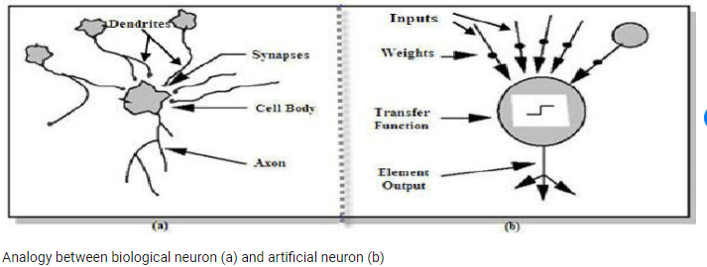
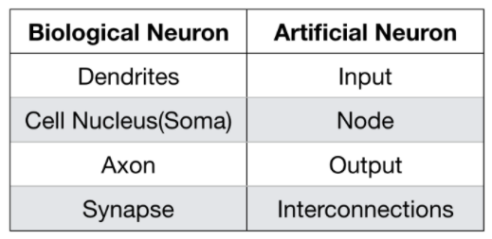

Slide 10
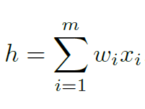
Each of these other neuronal firings flowed along a synapse to arrive at our neuron, and those synapses have strengths, called weights.
The strength of the synapse affects the strength of the signal, so we multiply the input by the weight of the synapse (so we get x1 × w1 and x2 × w2, etc.)
Strength of the neuron is,
Eg: w1 = 1,w2 = −0.5,w3 = −1, then the inputs to our model neuron are h = 1 × 1 + 0 × −0.5 + 0.5 × −1 = 1 + 0 + −0.5 = 0.5.
If Th =0, then fire, output = 1, if Th= 0.7 -> it will not fire, output =0.

Slide 11
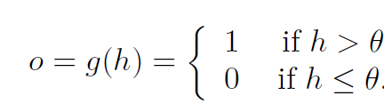
Decision about whether or not to fire (which is known as an activation function), as:
Change AF or weights for better outputs

Slide 12
Limitations
Linear summation (non linear)
Synchronous with clock (asynch)
Single output (spike train of output response)
Neuron has to produce graded output in continuous way
Changing weights between 0 and 1 (excitatory or inhibitory connections)
Feedback loop is not available (exceptions)(available)

Slide 13
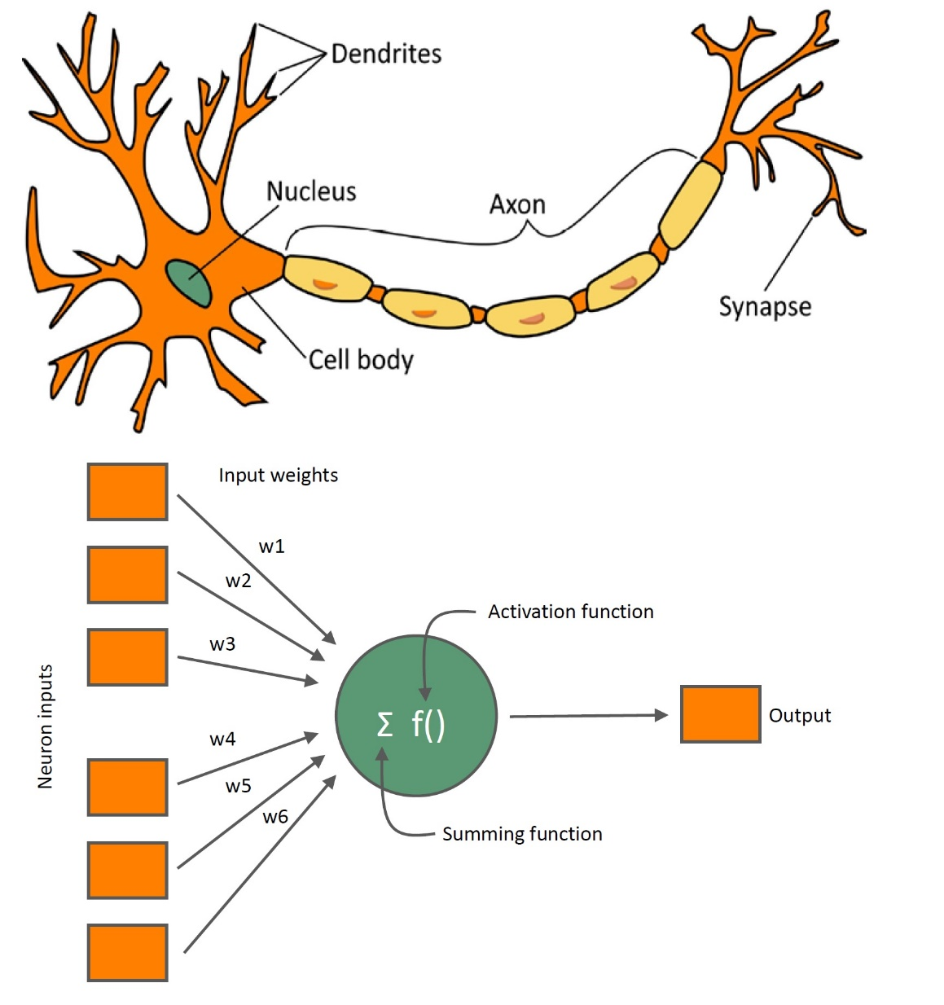

Slide 14
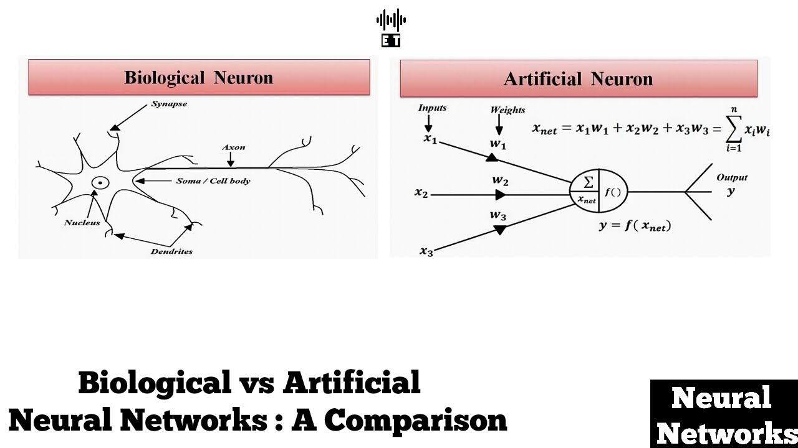

Slide 15
Neural Networks
Sets of neurons together into neural networks
Network of neuron instead of single one – to make it learn
The only things that make up the neuron are the inputs, the weights, and the threshold
Change the weights and the threshold
Learning happens between the neurons
How should we change the weights and thresholds of the neurons so that the network gets the right answer more often?
Perceptron

Slide 16
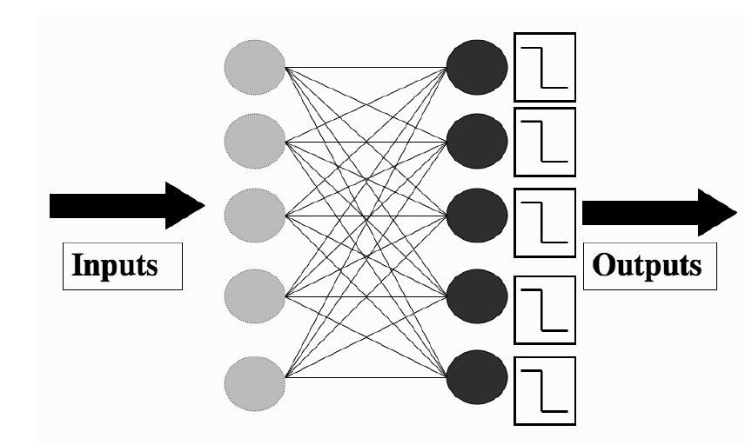
Perceptron
The Perceptron is nothing more than a collection of McCulloch and Pitts neurons together with a set of inputs and some weights to fasten the inputs to the neurons.
Neurons - completely independent of each other: Multiply its own weights and the input, adding them together, and comparing the result to its own threshold
There can be m inputs and n neurons weights were labelled as w_{i}, with the i index running over the number of inputs.
w_{ij ,}where the j index runs over the number of neurons.

Slide 17
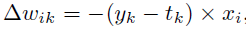
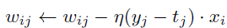
Set the values of the input nodes to match the elements of an input vector
Eg: output pattern could be (0, 1, 0, 0, 1)
For wrong output - Change the weights so that the neuron gets it right next time
There are m weights that are connected to that neuron, one for each of the input nodes.
If we label the neuron that is wrong as k, then the weights that we are interested in are w_{ik}, where i runs from 1 to m.
the new value of the weight is the old value plus this value.
learning rate

Slide 18
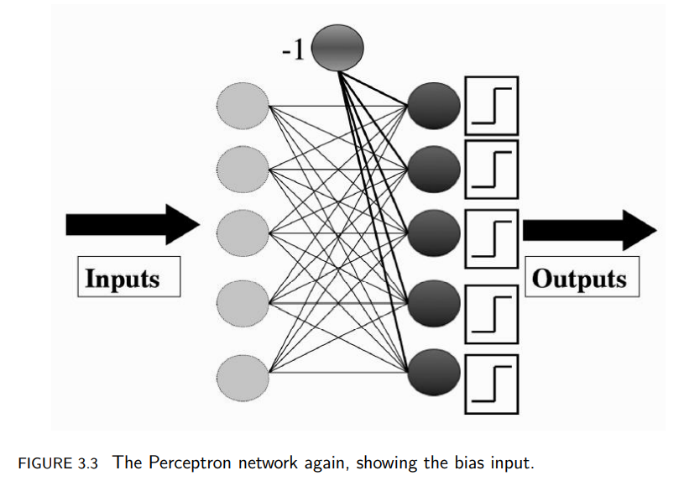
Bias Input

Slide 19
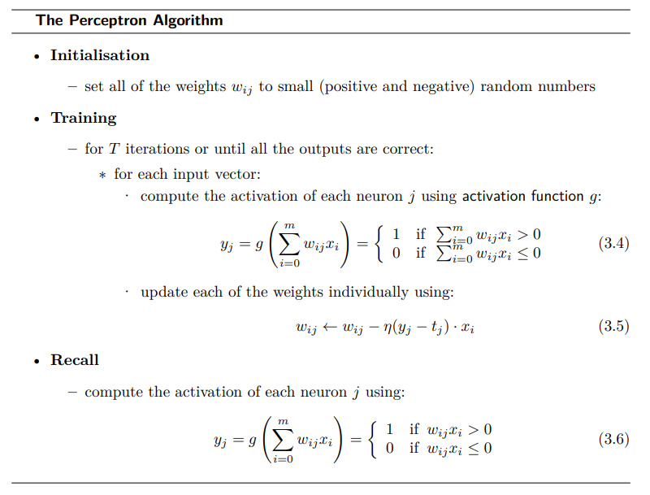

Slide 20
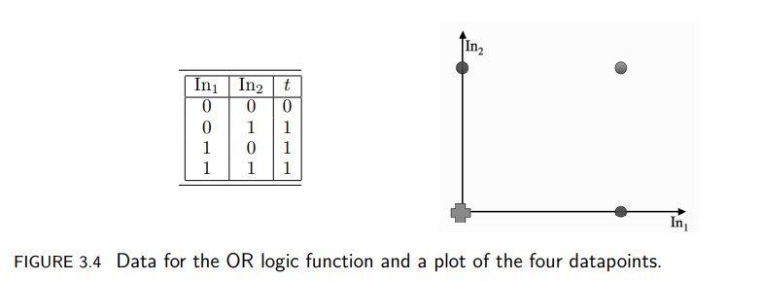

Slide 21
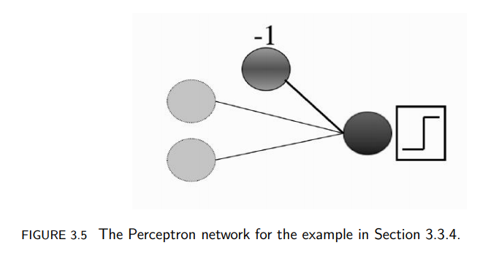

Slide 22
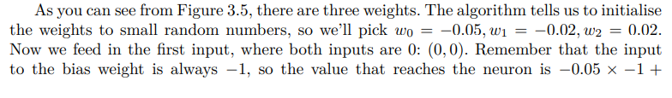
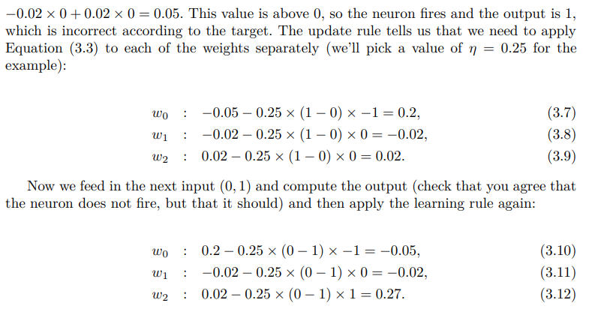

Slide 23
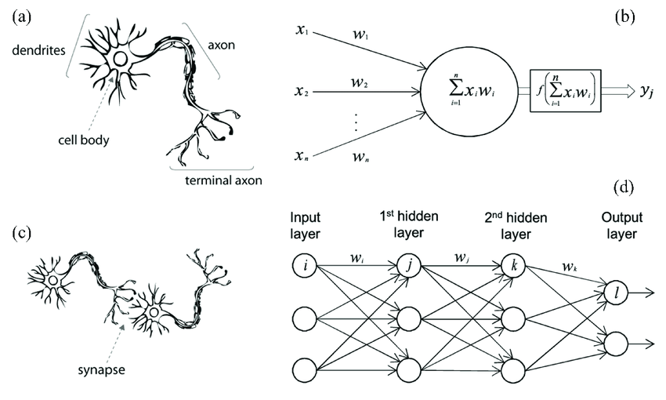

Slide 24
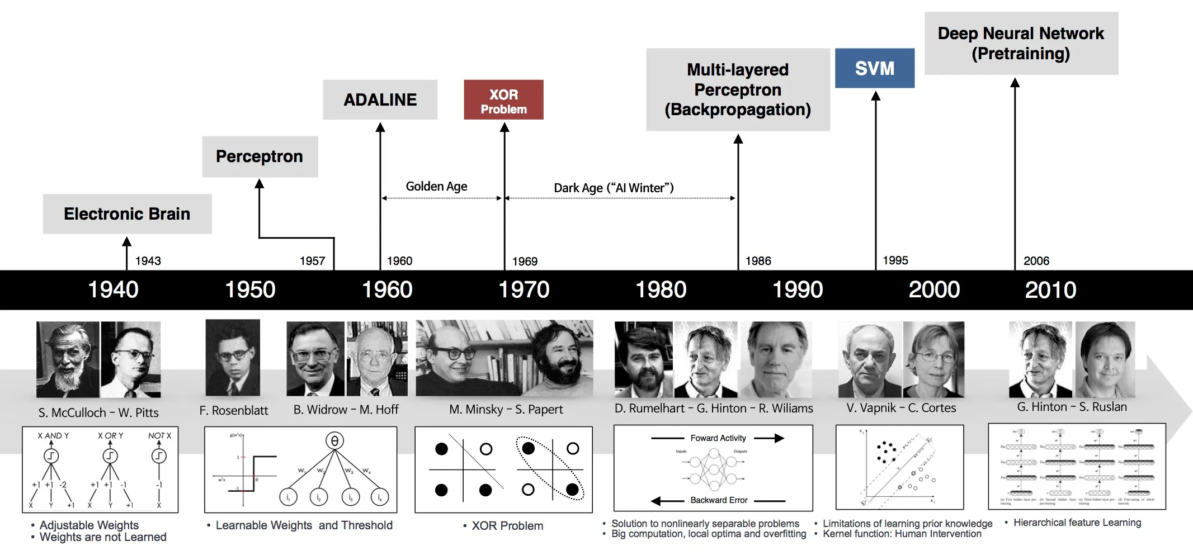
Evolution of Neural Network

Slide 25
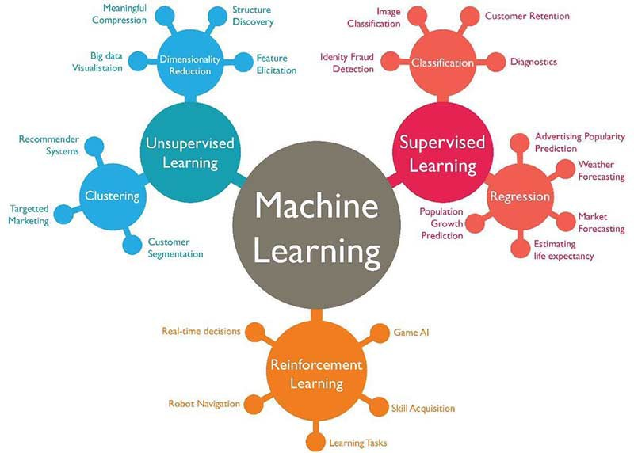

Slide 26
Summary
The brain and the neuron
Neural networks
The Perceptron

Slide 27
THANK YOU
Courtsey : Stephen Marsland

